Slide 1

Department of Information Technology
NBA Accredited A.P. Shah Institute of Technology G.B.Road,Kasarvadavli, Thane(W), Mumbai-400615 UNIVERSITY OF MUMBAI Academic Year 2022-2023

Slide 2
A Project Report on Developing Comprehensive Application for Tracking Services Submitted in partial fulfilment of the degree of
Bachelor of Engineering(Sem-8) in INFORMATION TECHNOLOGY By Atharva Tambde (19104048) Rajvi Shah (20204001) Jay Mahajan (19104063) Under the Guidance of Anagha Aher & Sheetal Agrawal

Slide 3
1.Project Conception and Initiation

Slide 4
1.1 Abstract
Outdated library management techniques can cause data loss and reduce transaction effectiveness.
Smart library systems using machine learning can automate book circulation and benefit library staff and students.
Text recognition models create and retrieve up-to-date library inventories that are easy to access.
Automated library systems reduce manual work, improve accessibility, and maintain library relevance in the digital age.

Slide 5
1.2 Objectives
To create a mobile application for the automatic process of library management system using different features of Android studio IDE.
To provide dynamic user interface using XML (extensible Mark-up Language).
To create a book recommendation system using collaborative filtering Machine learning algorithm.
To store and processed the data using object storage service of Firebase.

Slide 6
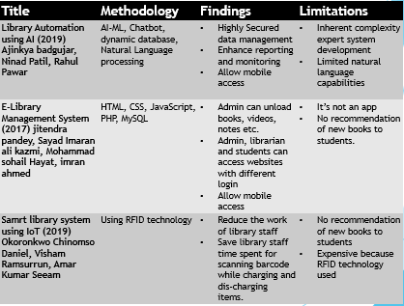
1.3 Literature Review

Slide 7
1.4 Problem Definition
Today's pen and paper library management system have some drawbacks like prone to damage where Manual documents can be easily damaged, lost, misplaced or stolen.
Libraries are used to store books, but require a system to navigate to specific book or specific content within a book.

Slide 8
1.5 Scope
The project aims to provide an efficient and user-friendly system for tracking library services.
The system will allow users to search for books, issue books, and view the books they have previously borrowed.
The system will also provide librarian/admin access for tasks such as adding books, removing books, reissuing books, issuing books, collecting fines, updating book details, and returning books.
An ML model for book recommendations is built, which will suggest books to users based on their reading habits and behaviours.

Slide 9
1.6 Technology stack
Java
Android Studio
XML (Extensible Mark-up Language)
Firebase real-time Database
Jupyter Notebook
Python Libraries

Slide 10
1.7 Benefits for environment & Society
Reduce paper usage and promote environmental sustainability.
Increase accessibility and convenience for all users, regardless of physical location.
Enhance user experience and satisfaction through efficient and user-friendly features.
Encourage and support lifelong learning and education for individuals and communities.
Promote equal access to information and resources, regardless of socioeconomic status.

Slide 11
2. Project Design

Slide 12
2.1 Proposed System
System Application : Automates book issuing, re-issuing, and returning processes.
Recommendation System : It recommends book which are newly added to a library.
Real Time database : The proposed system provides superior data management capabilities, resulting in more efficient data processing.

Slide 13
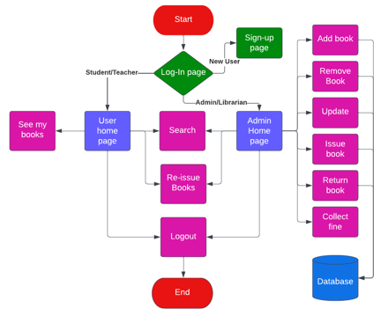
2.2 Design(Flow Of Modules)

Slide 14
2.3 Description Of Use Case
Users are able to log in to the application and issue books based on their interests and the availability of the books in the library.
The librarian can monitor all processes related to book issuance, reissuance, returns, and fine collection.
The use of a machine learning model for book recommendations allows the system to suggest books to users based on their reading preferences and behaviours. This enhances the user experience and promotes lifelong learning.

Slide 15
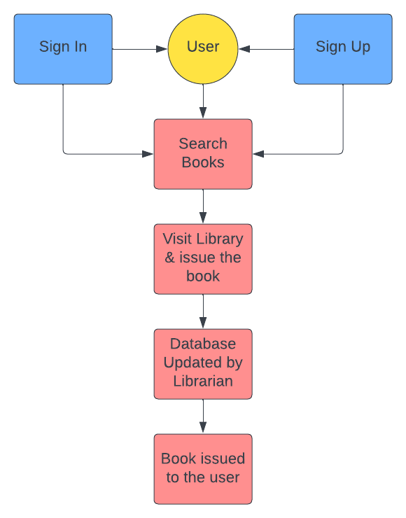
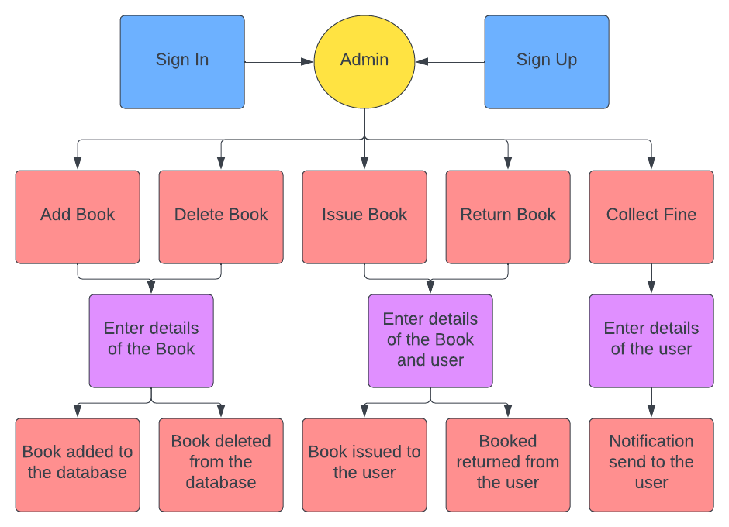
2.4 Activity diagram

Slide 16
3. Implementation

Slide 17
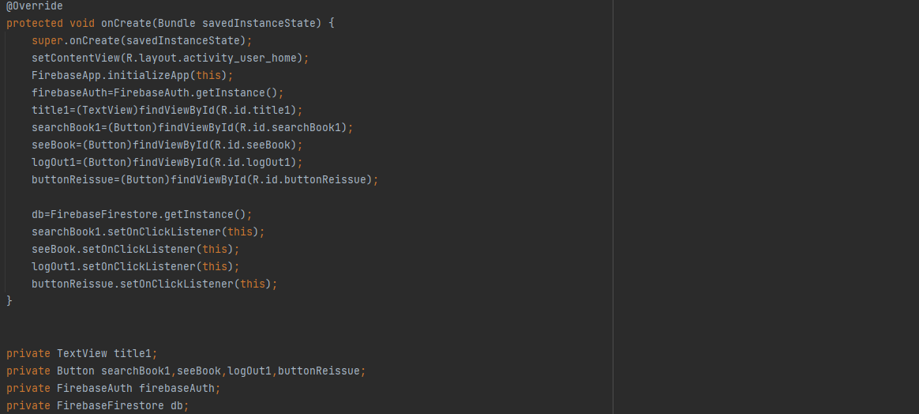
User Home Page

Slide 18
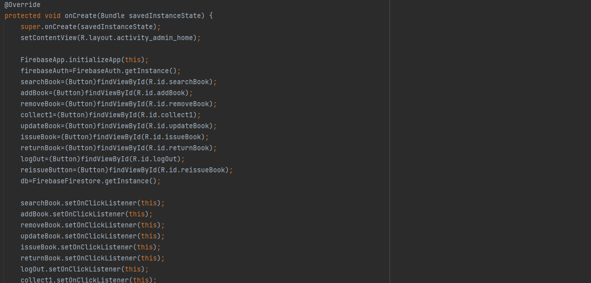
Admin home page

Slide 19
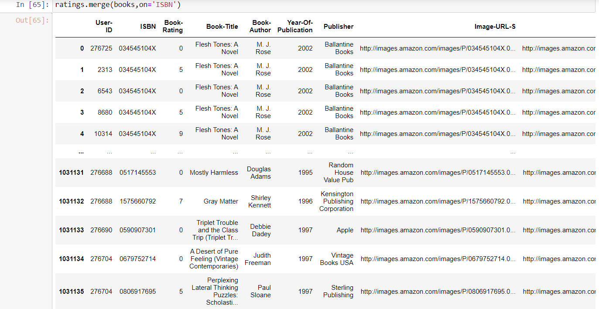
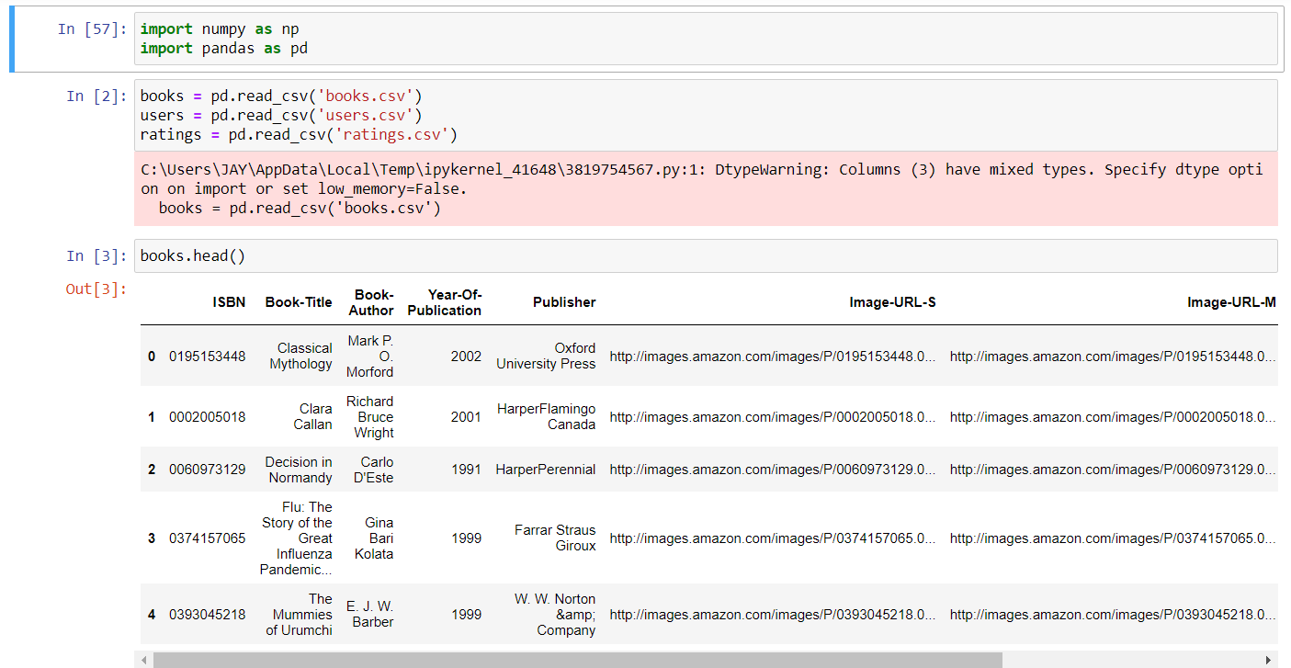
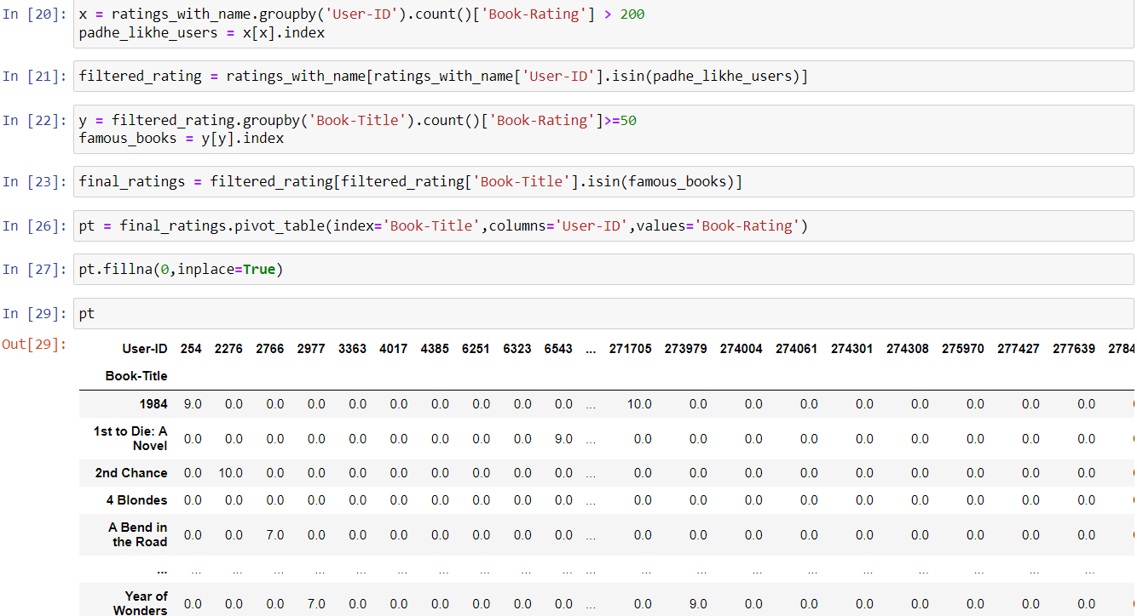

Slide 20
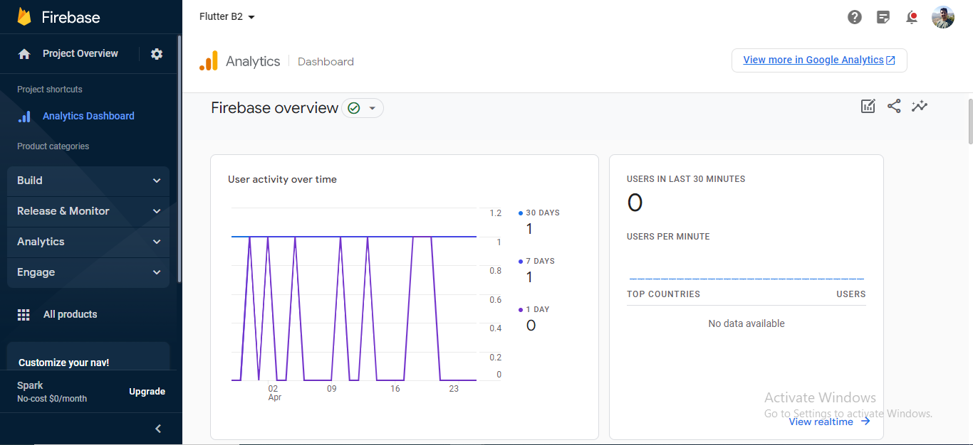
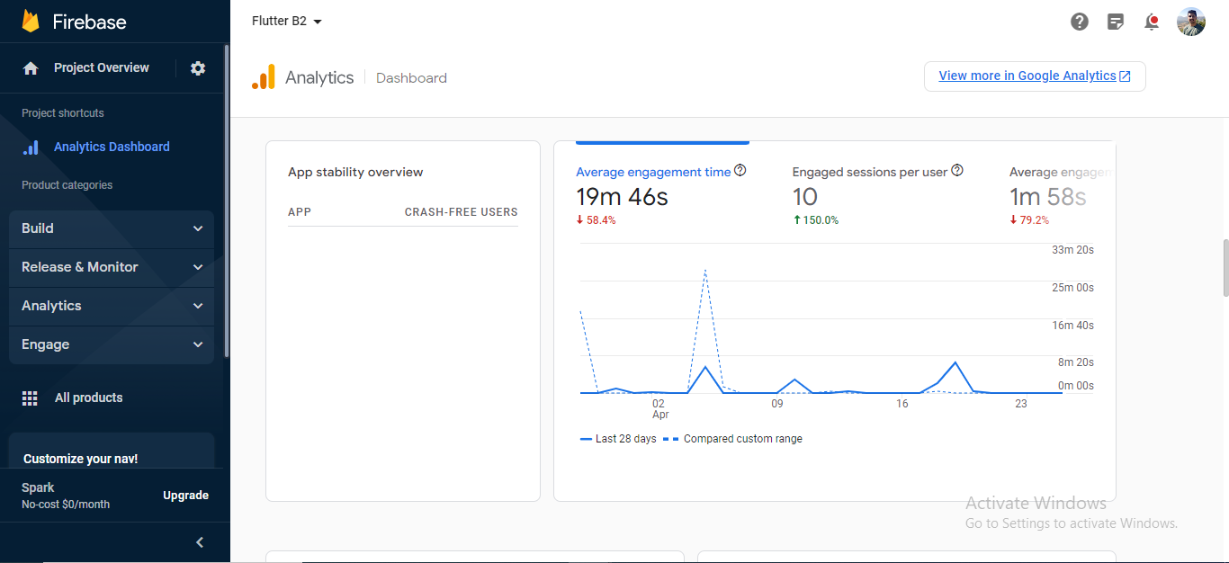

Slide 21
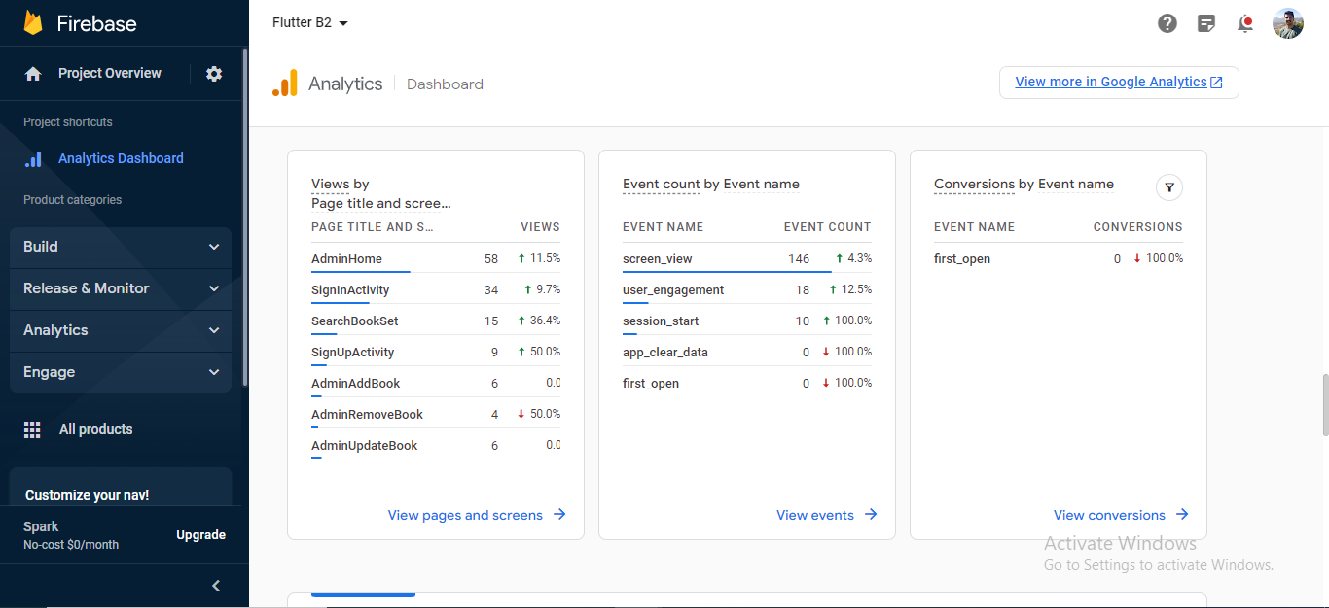
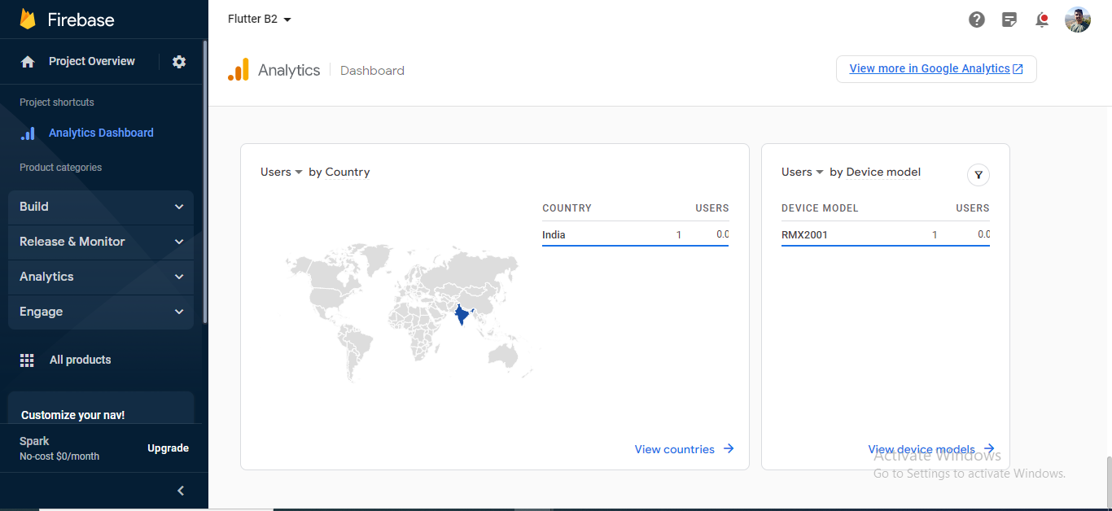

Slide 22
4. Testing

Slide 23
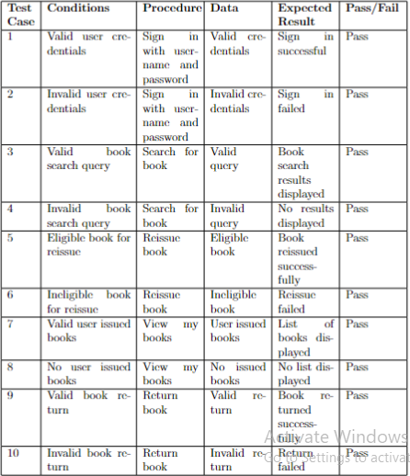

Slide 24
5. Result

Slide 25
The library service tracking application being created is a major improvement over current library administration systems.
The android-compatible software allows users to view their book issuance history, issue and reissue books, and search for books.
Administrators can add/remove books, update book information, issue and reissue books, collect fines, and handle returns.
The user-friendly interface, efficient workflow, and effective search engines enable users to find books easily and complete their intended activities quickly.

Slide 26
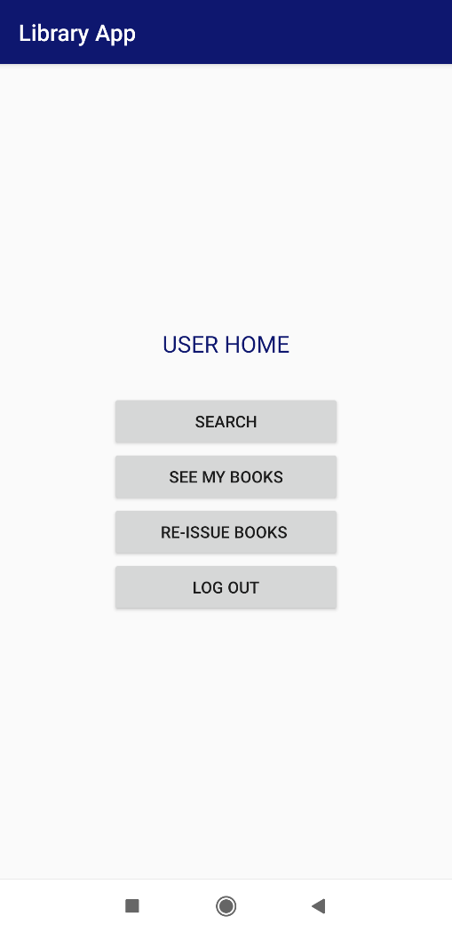
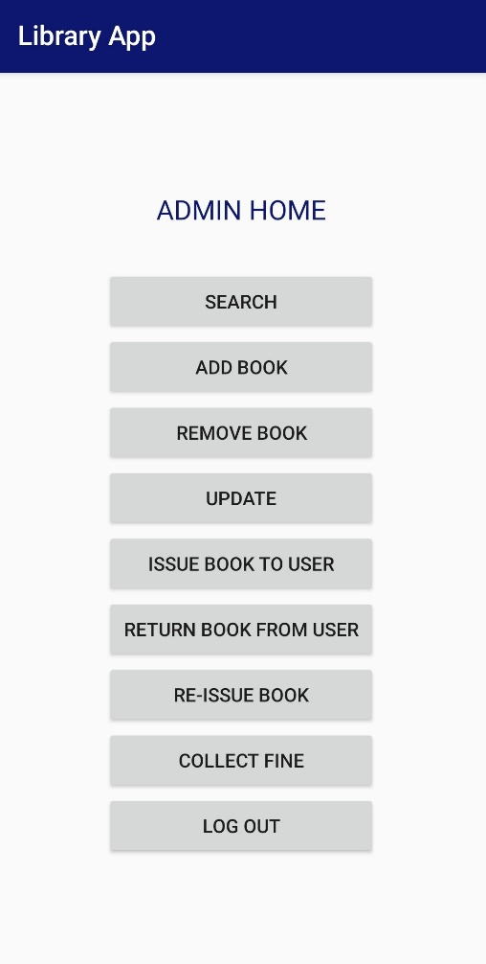
Admin home page
User home page

Slide 27
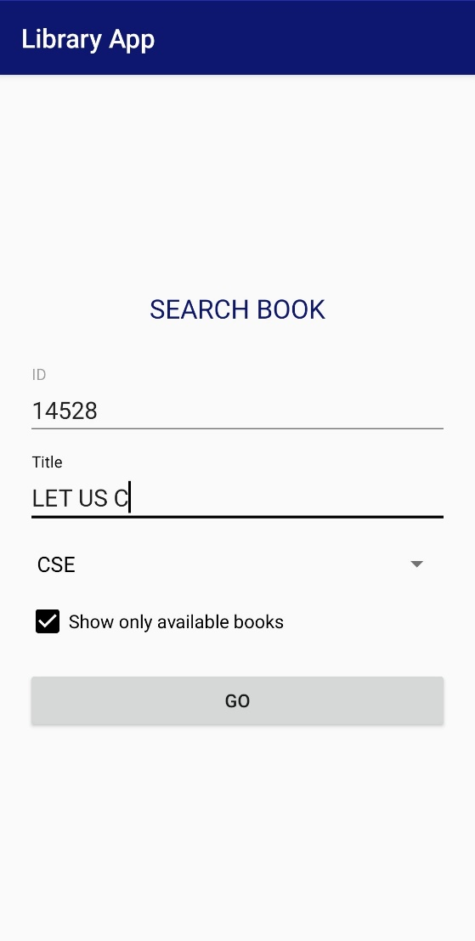
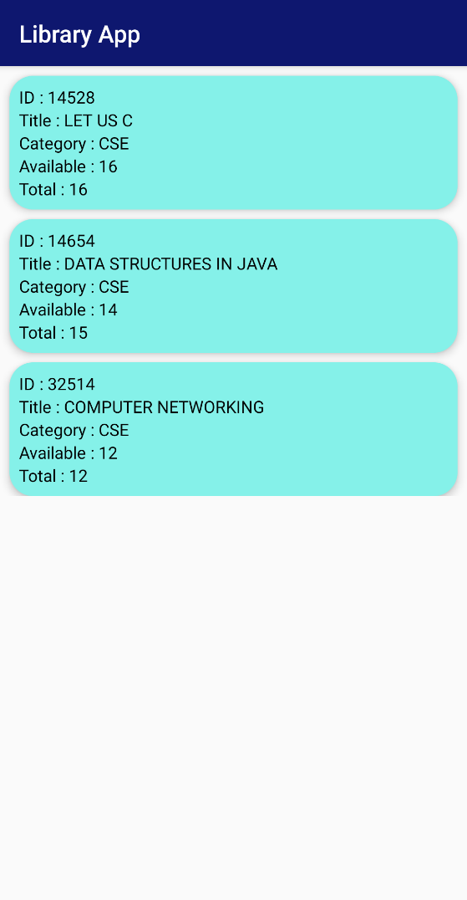
Search book result
Search book

Slide 28
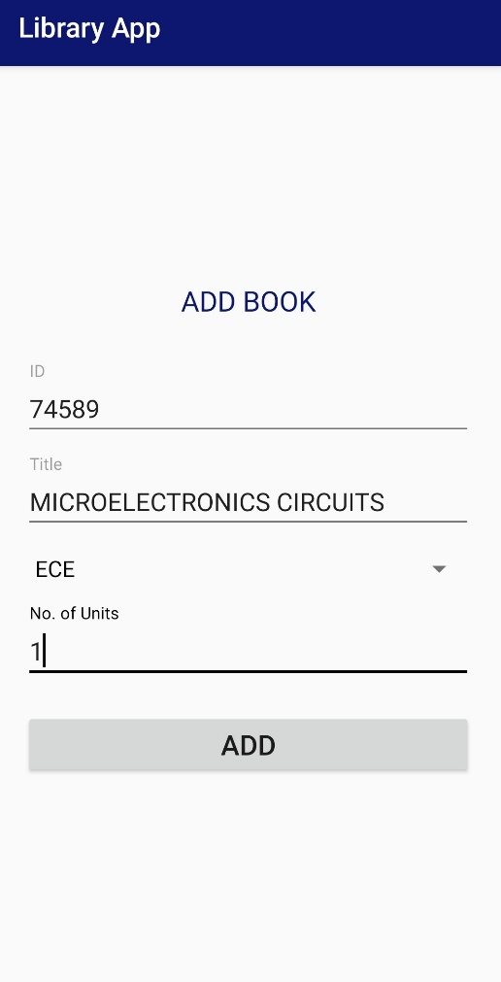
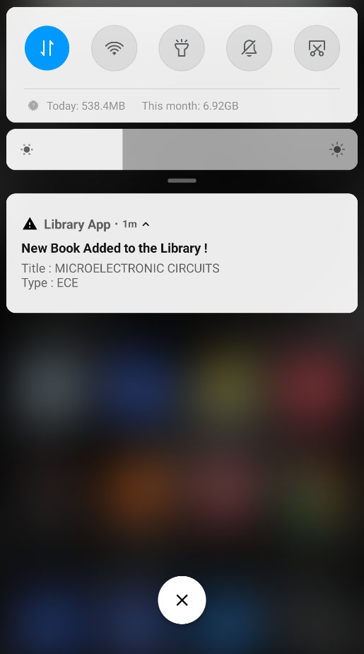
Add book
Add book notification

Slide 29
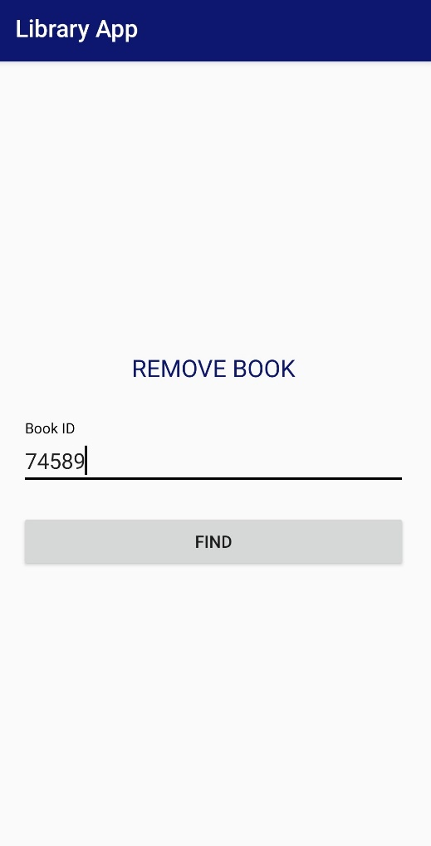
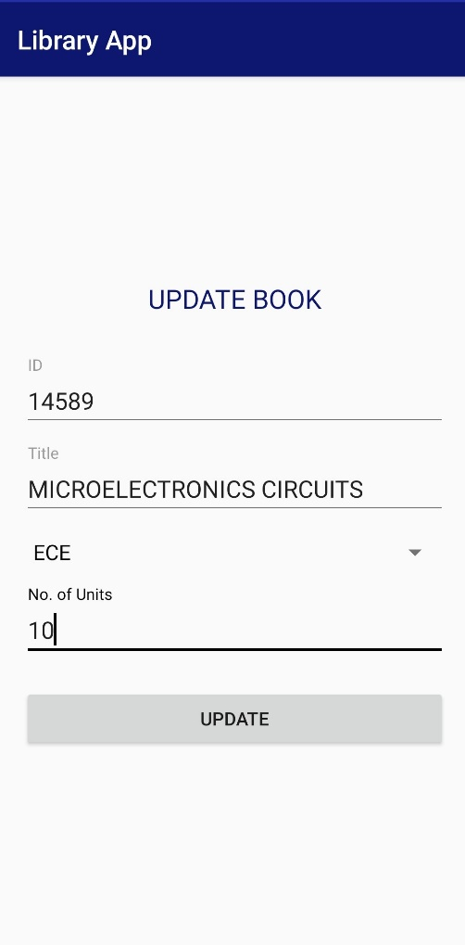
Remove book
Update book

Slide 30
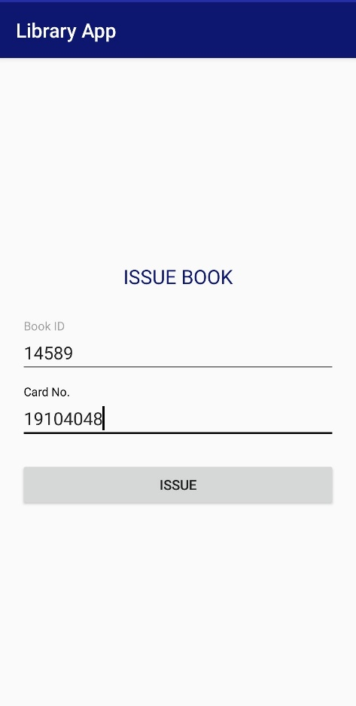
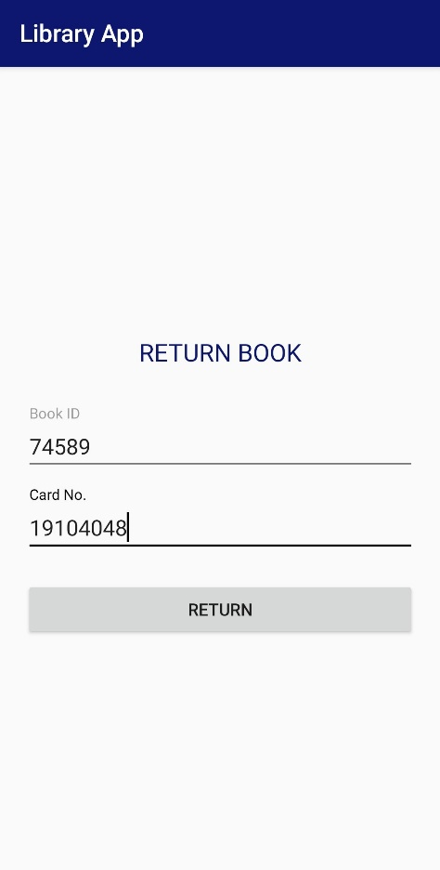
Issue book
Return book

Slide 31
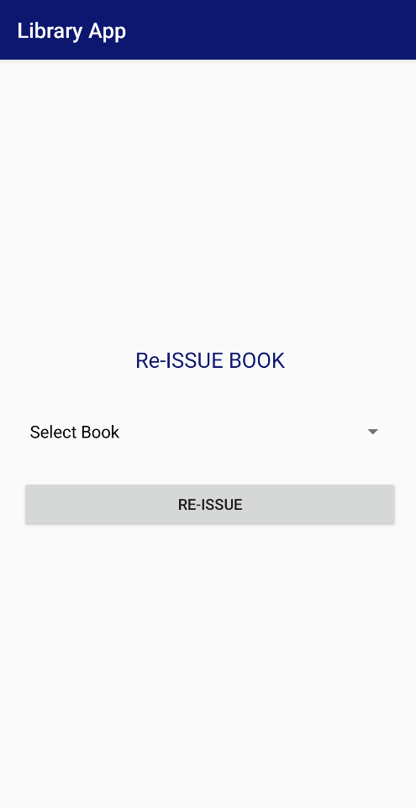
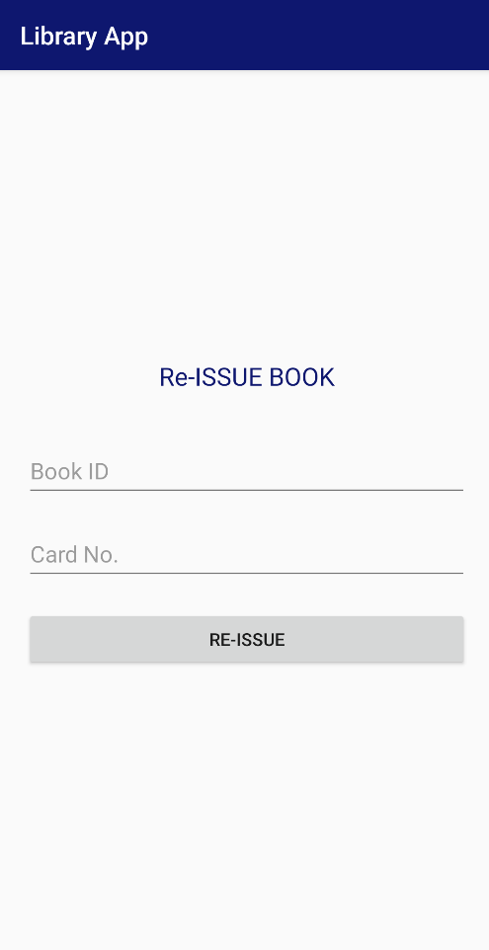
Admin re-issue book page
User re-issue book page

Slide 32
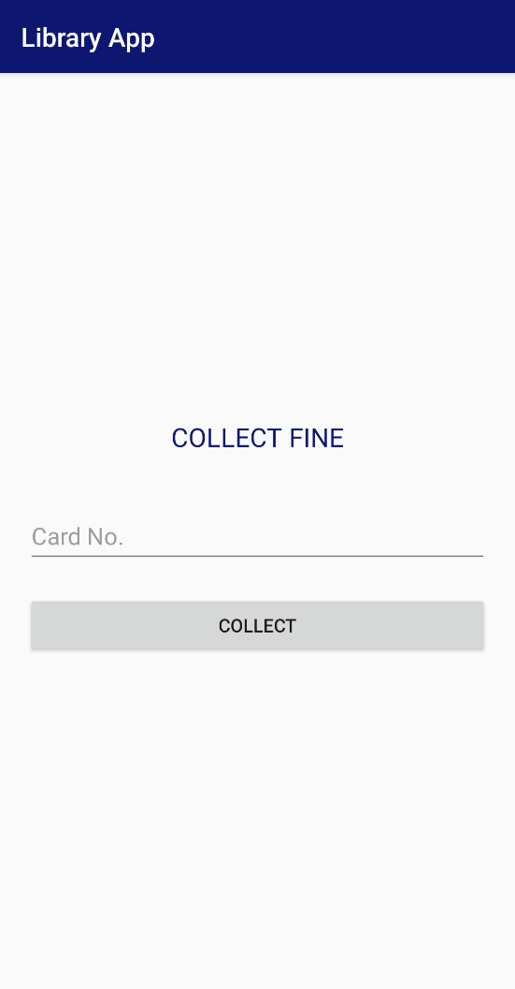
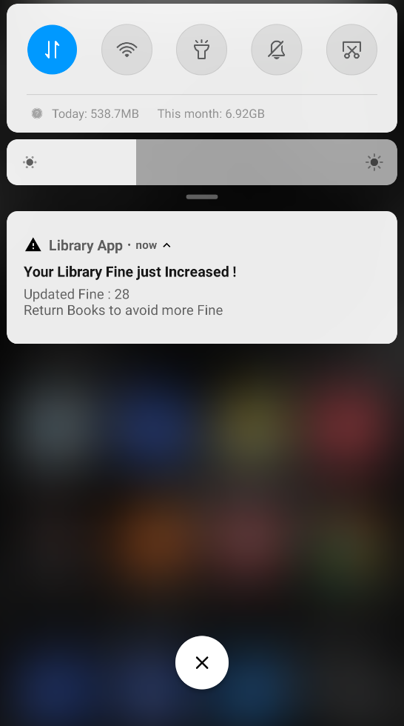
Collect fine notification
Collect fine

Slide 33
6. Conclusion and Future Scope

Slide 34
Conclusion
The study aims to improve the conventional approach to library management that involves manual work.
An online library management system is the solution to the problems caused by manual work, as it automates and digitizes the process.
The Java-based application is connected to a relational database, which allows for efficient management of library resources.
The application will help staff track their time and resources more effectively.

Slide 35
Future scope
Sophisticated search capabilities to enable users to search for books based on specific criteria like publisher, ISBN, or edition can be added to improve the user experience.
Integration of the system with external information sources like online databases or e-book collections can broaden the library's collection beyond physical books.
Data analytics and visualization tools can be integrated into the system to provide insights into how the library's collection is being used and which books are most popular among users.

Slide 36
References
Pandey, Jitendra, et al. "A study on implementation of smart library systems using IoT." 2017 International Conference on Infocom Technologies and Unmanned Systems (Trends and Future Directions)(ICTUS). IEEE, 2017.
Okoronkwo Chinomso, Visham Ramsurrun, and Amar Kumar Seeam. "Smart library seat, occupant and occupancy information system, using pressure and RFID sensors." 2019 Conference on Next Generation Computing Applications (NextComp). IEEE, 2019
Vidhate, Prof, et al. "A Review on Library Automation Using Artificial Intelligence." JETIR-International Journal of Emerging Technologies and Innovative Research (www. jetir. org), ISSN (2019): 2349-5162.

Slide 37
Publication
Paper entitled “Developing Comprehensive Application for Tracking Library Services” is presented at “International Conference on Contemporary Challenges in Science and its Engineering Applications(IC3SEA 2023)” by “Atharva Tambde, Rajvi Shah, Jay Mahajan, Anagha Aher, Sheetal Agarwal” on 5th-6th May 2023 at Study World College of Engineering Palathurai, Coimbatore, Tamilnadu, India.

Slide 38
Thank You

